Slide 1
Schools Against Plastic
By the Eco Council

Slide 2
Introduction
In this powerpoint we are talking about plastic. Milltown has joined the Schools Against Plastic scheme. As a school we have pledged to stop using single use plastic whenever we can.

Slide 3
We are now going to tell you how dumping plastic is bad for the environment.

Slide 4
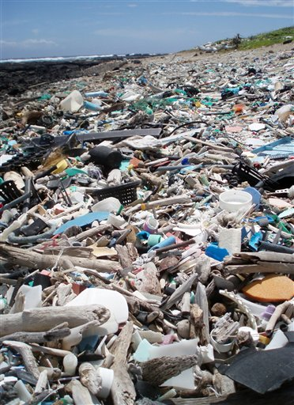
Non-Reusable Plastic Usage Leads To This
We are killing this planet, we can help. By pledging to stop this lazy behaviour we can save a whole planet. By pledging to stop this blasphemy we must stay true to our code of honour because our beautiful gardens and beaches are dying.

Slide 5
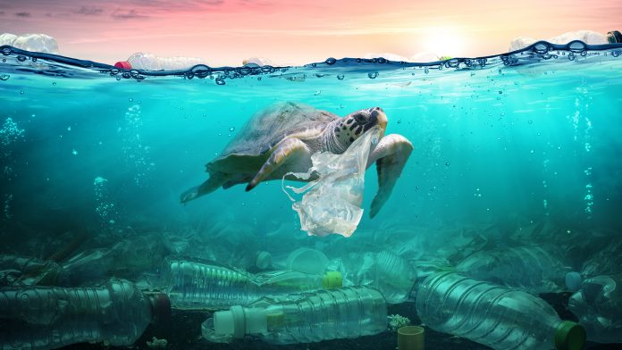
Animals can be sick because of plastic we throw in the sea
Some animals get caught or swallow plastics that we are responsible for throwing in the sea. If your mum or dad or anybody you know throws anything into the sea tell them to stop and that it could really damage the amount of the animals in the sea because you have thrown some of that plastic in the sea.

Slide 6
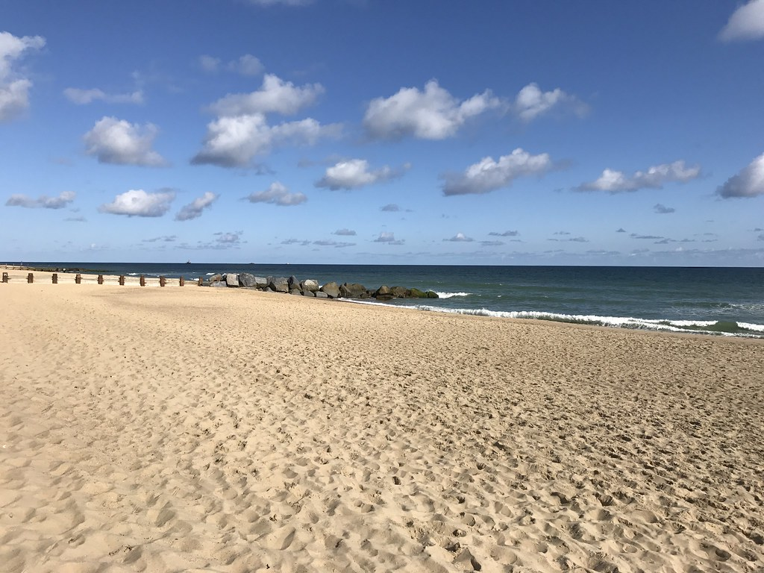
Which do you prefer?
We can help to prevent this mess by recycling plastic bottles or any type of plastic you use. People can also cut themselves with plastic because the wind could just blow the plastic everywhere and easily cut people. The cleaner side is much better because noting is there to harm you.

Slide 7
Money Wasted and the Cows Taste It
Hundreds of cows have died and are dying because of humans dumping plastic. We need to stop this people. Cows give us milk and some give their lives for our beef that we eat.

Slide 8
Plants don’t like it either!
Plants don’t like it either. It’s not fair on the plants because plastic is not being dealed with as it should be. Plastic can be wrapped around young trees but if it is not taken off the tree will not do well when it comes to producing its fruit. Where the plastic is tied, the tree will start to form a lump where the life is not going all the way round the tree.

